Slide 1

Lecture: BarChart
Topics: Using plotting library

Slide 2

Which Library to use?
There are plenty. Pick any.
We will use MPAndroidChart as an example.
https://github.com/PhilJay/MPAndroidChart

Slide 3
Gradle Setup
Modify the build.grade (two separate files):
repositories {
maven { url 'https://jitpack.io' }
}
dependencies {
implementation 'com.github.PhilJay:MPAndroidChart:v3.1.0'
}

Slide 4
Add UI Element
Add the chart element to the layout xml:
<com.github.mikephil.charting.charts.BarChart android:id="@+id/mybar" android:layout_width="match_parent" android:layout_height="wrap_content" />

Slide 5
Prepare and show the chart
Prepare and show the bar chart (minimal code):
barChart = findViewById(R.id.mybar); ArrayList<BarEntry> arr = new ArrayList<>(); arr.add(new BarEntry(1, 10)); arr.add(new BarEntry(2, 30)); arr.add(new BarEntry(3, 20)); BarDataSet barDataSet = new BarDataSet(arr, "Dataset 1"); BarData bardata = new BarData(barDataSet); barChart.setData(bardata);

Slide 6

We can see it, but not quite
The lack of formatting is evident!

Slide 7
Format the chart
API provides several formatting options:
BarDataSet barDataSet = new BarDataSet(arr, "Dataset 1"); barDataSet.setColors(ColorTemplate.MATERIAL_COLORS); barDataSet.setValueTextColor(Color.BLACK); barDataSet.setValueTextSize(11f); BarData bardata = new BarData(barDataSet); barChart.setFitBars(true); barChart.setMinimumHeight(500); barChart.getDescription().setText("copyright"); barChart.setData(bardata);
barChart.animateY(1000);

Slide 8
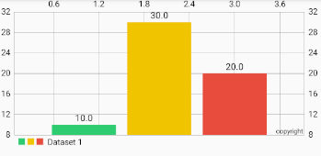
Looking better

